Slide 2
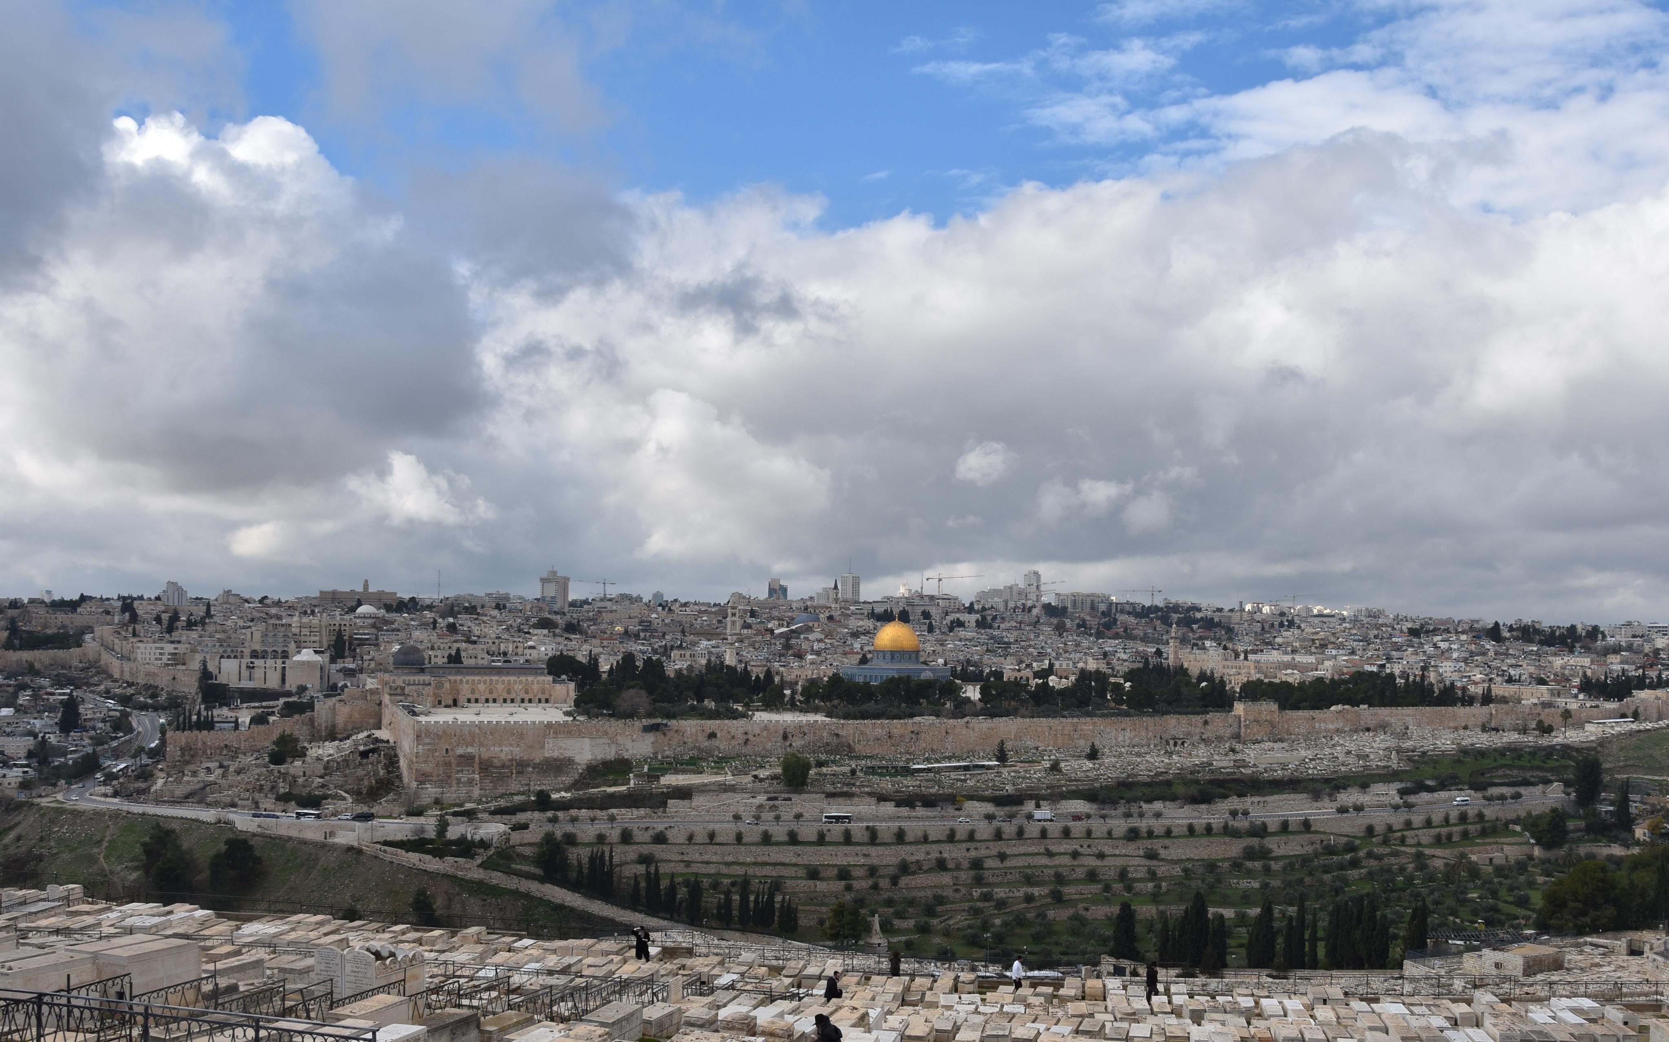
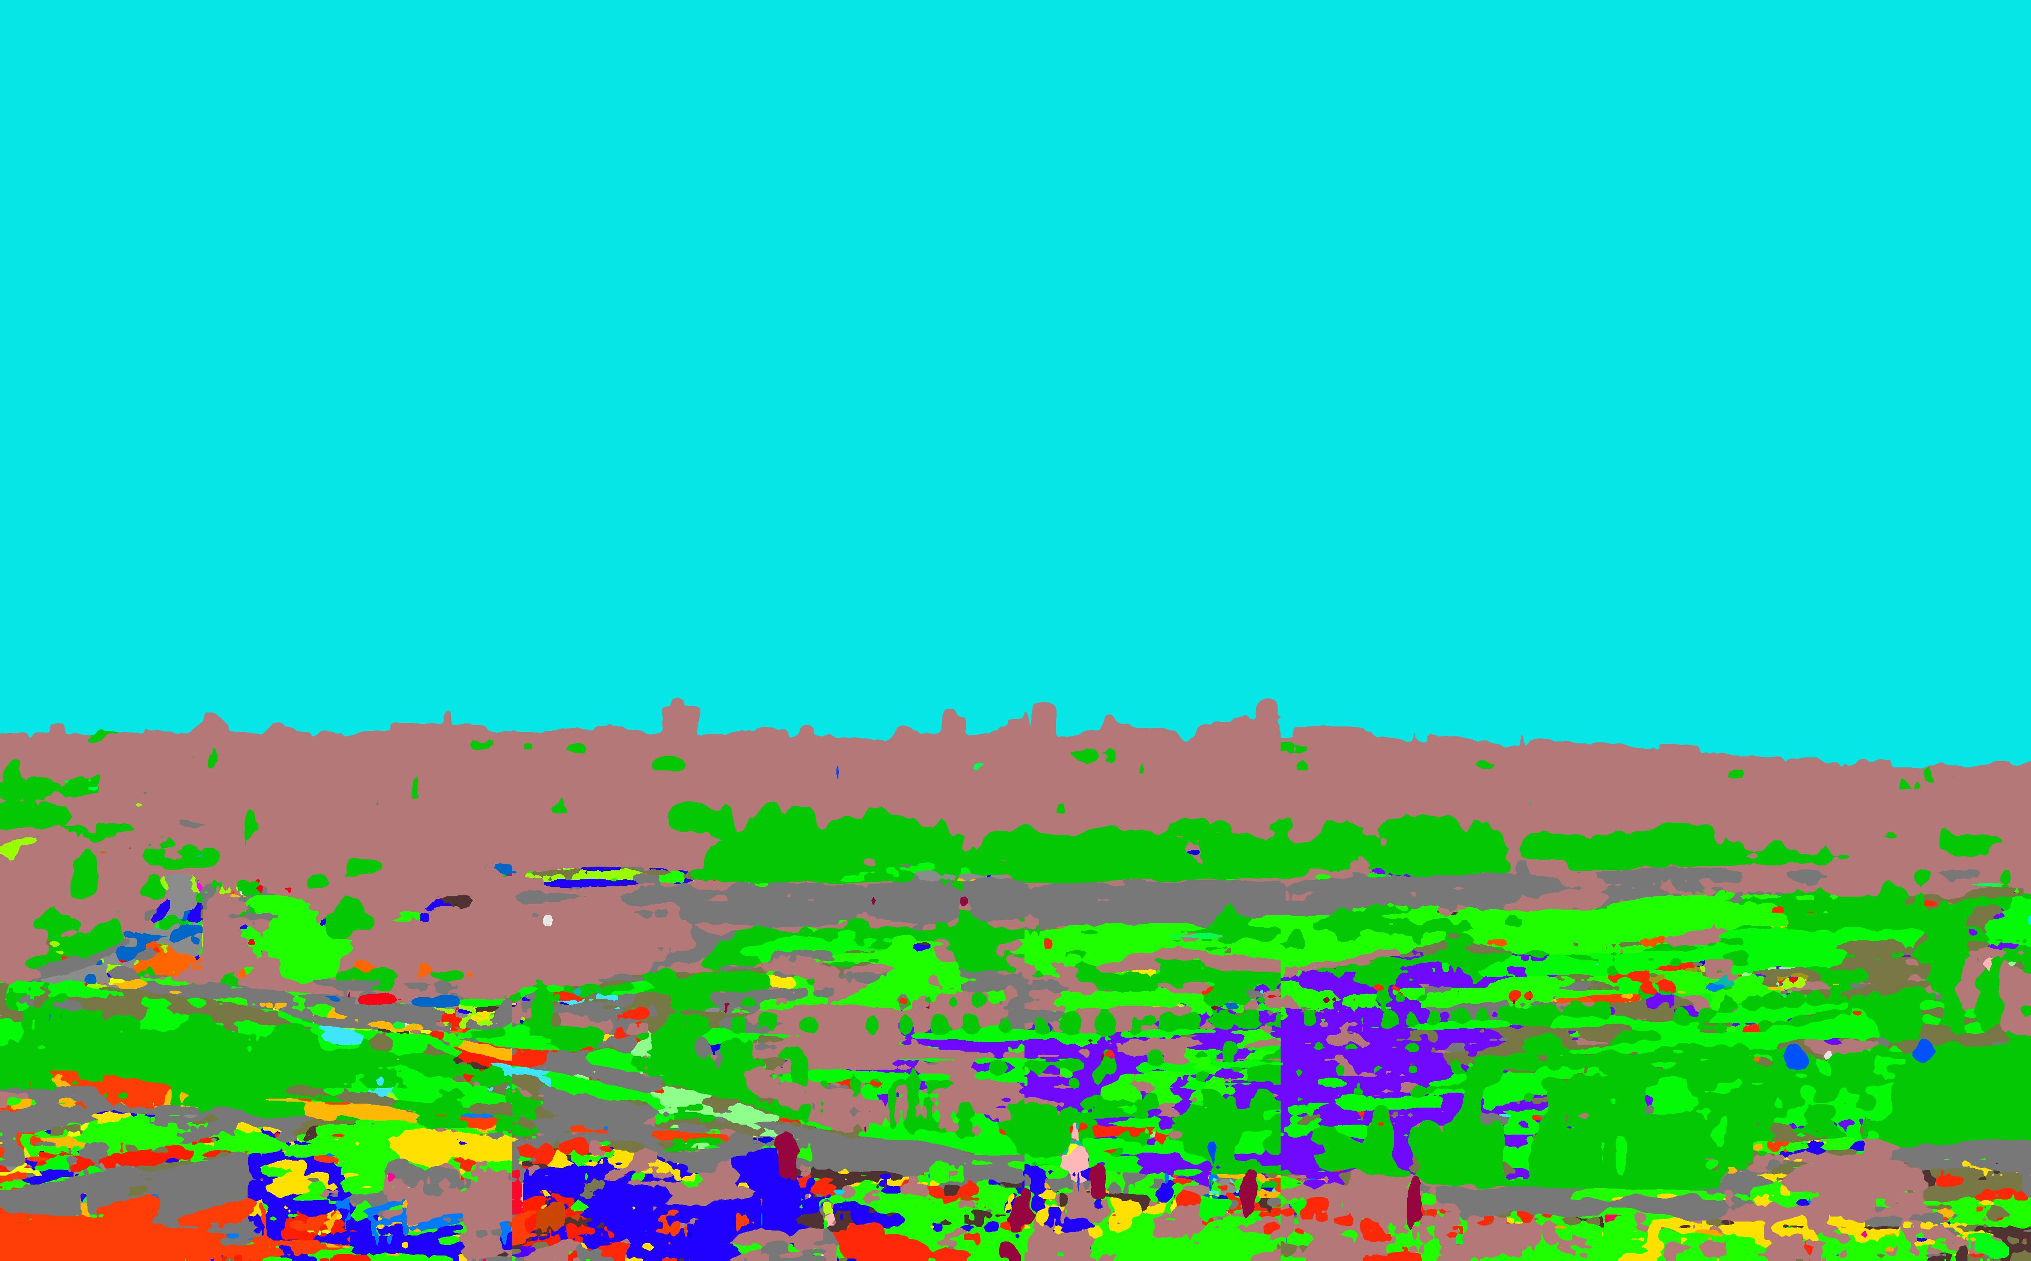

Slide 3

sky

Slide 4

building

Slide 5

Tree

Slide 6

Wall

Slide 10
Sky

Slide 12
buildings

Slide 14
Grass

